Slide 1
Advanced C Programming
HGU

Slide 2
How to Copy Source Codes for Labs
1. Copy recursively my local directory to remote host scp command in Windows /macOS command
C:\> scp –r <source-directory> <uid>@<remote_url>:<remote_path>
2. Download from github.com
(https://github.com/kangyi/SystemProgrammingCode)
2-1 visit github server https://github.com/kangyi0/SystemProgrammingCode
and download the repository as a ZIP file
2-2 clone github repository to local machine using git command
$ git clone https://github.com/kangyi/SystemProgrammingCode

Slide 3
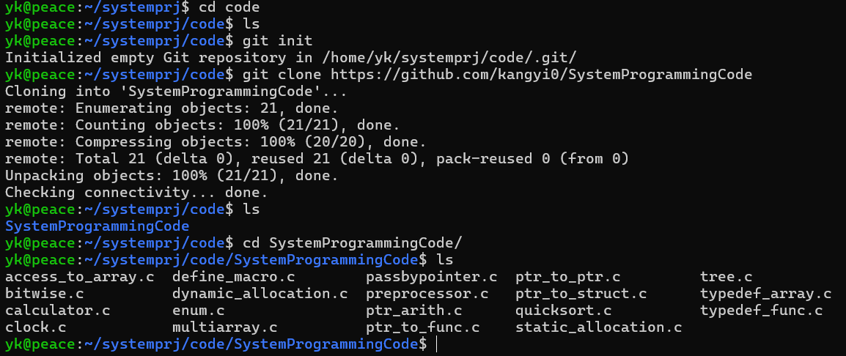
Copy Test source code by Git Clone
$ git clone https://github.com/kangyi/SystemProgrammingCode

Slide 4
Agenda
0. Quiz
Finding Errors in C
Build Process and Compile Options
Compiler Directives
3. Pointer
Pointer as Argument
Pointer Arithmetics
Arrays and Pointers
Pointer to Structure
Pointer to Function
4. typedef
5. Bitwise Operations
Notes:
<- 주의코드
bitwise operator <- binary_io
compiler directives <- compiler_directives
enum <- enum_structure_union
pointer
pointer to pointer
pointer to array <- pointer_2Darray
pointer to struct <- enum_structure_union
pointer to function <- function_pointer
typedef
typdefef for struct
typedef for function
typedef for array
typedef for complex data structure
command line argument

Slide 5
0. What is wrong in this code?
err_code1.c
int main() { int a = -1, b = 0, c = 2; if (a < b < c) printf("a < b < c\n"); else printf("a >= b or b >= c\n"); if (3 > c > 1) printf("1 < c < 3\n"); else printf("1 >= c or c >= 3\n"); return 0; }
The intention
a < b < c 1 < c < 3
How to Fix it
for the Intention?
(a < b < c) → ((a < b) < c) → ((-1 < 0) < 2) → (1 < 2) → 1 (true)
(3 > c > 1) → ((3 > c) > 1) → ((3 > 2) > 1) → (1 > 1) → 0 (false)
Notes:
-Og : -O1 수준의 최적화를 수행하되, 디버깅 정보의 손실을 최소화하여 디버깅에 최적화됨
-Os : -O2 수준의 최적화 중에서 실행 파일 크기를 증가시키는 최적화를 제외한 최적화 적용.
-Ofast : -O3 수준의 최적화와 함께 IEEE 표준을 무시하는 최적화도 포함하여 성능에 올인.

Slide 6

0. What is wrong in this code?
err_code2.c
main() { char * s; int i; gets(s); for(i=0; s[i] != ‘\0’; i++) { if(s[i] >= ‘a’ && s[i] <= ‘z’) s[i] = s[i] –’a’ + ’A’; /* capitalize */ else if(s[i] >= ‘A’ && s[i] <= ‘Z’) s[i] = s[i] – ‘A’ + ‘a’; /* convert to lower*/ } puts(s); }
Expected Result
Hello World ! hELLO wORLD !
Execution Result
.
Pointer s does not allocated → s = (char*)malloc(sizeof(s));
fgets() is preferred for safe
Notes:
“fgets() is preferred for safe”는 원본에서 언급되지 않았음. 실행 시 발생한 문제
(https://docs.google.com/presentation/d/1Aon3mRNCkiJnYE9C2tvqddTfyxZrKIfFn1ap4HsU8TE/edit#slide=id.p4)

Slide 7
0. What is wrong in this code?
err_code3-1.c
STUDENT *get_person(char *name, int id){ STUDENT s; s.name = name; s.id = id; return &s; } int main() { STUDENT *s1; s1 = get_person("James",1); printf("%s %d\n", s1->name, s1->id); return 0; }
err_code3.c
typedef struct { char *name; int id; } STUDENT; main() { struct STUDENT s1, s2; s1.name = “James”; s1.id = 1; s2 = s1; }
Use typedef alias STUDENT instead of struct STUDENT for consistency
Memory for strings does not allocated before copying it
Also, use strcpy() for copying string content
Returning local variable address is Dangerous!
Notes:
-Og : -O1 수준의 최적화를 수행하되, 디버깅 정보의 손실을 최소화하여 디버깅에 최적화됨
-Os : -O2 수준의 최적화 중에서 실행 파일 크기를 증가시키는 최적화를 제외한 최적화 적용.
-Ofast : -O3 수준의 최적화와 함께 IEEE 표준을 무시하는 최적화도 포함하여 성능에 올인.

Slide 8
0. What is wrong in this code?
err_code4.c
typedef struct { char *name; int credit; } COURSE; typedef struct { char *name; int id; COURSE *currcourse[8]; }STUDENT; main() { COURSE subjects[] = {{“Calculus”,3}, {“C Lang”,2}, {“English”,3}, {“Chapel”,0}}; STUDENT regs[] = {{“James”, 12, NULL}, {“Julie”,23,NULL}, {“John”,31, NULL}}; regs[0].currcourse[0] = &subjects[0].name; regs[1].currcourse[0] = &subjects[1]; regs[1].currcourse[1]->name = regs[0].currcourse[0]->name; }
Error: Type mismatch:!
register[0].currcourse[0] is a type of Course * (pointer to Course),
but assigning it to a type of char * (pointer to char : name field of Course)
Notes:
-Og : -O1 수준의 최적화를 수행하되, 디버깅 정보의 손실을 최소화하여 디버깅에 최적화됨
-Os : -O2 수준의 최적화 중에서 실행 파일 크기를 증가시키는 최적화를 제외한 최적화 적용.
-Ofast : -O3 수준의 최적화와 함께 IEEE 표준을 무시하는 최적화도 포함하여 성능에 올인.

Slide 9
1. Build Process
Compilation Steps
Preprocessing directives such as #define and #include
Compilation translates the source code to assembly code (.s)
Assembly converts the assembly code into relocatable binary object code (.o)
Linking creates a executable file from relocatable binaries (.o) and libraries (.a or .so)
Pre-processing
Compilation
Assembly
Linking
Source Code
(*.c)
Preprocessed Source Code
(*.i)
Assembly File
(*.s)
Object File
(*.o)
Executable File
(a.out)
Header File
(*.h)
Object File
(*.o)
Library
(*.a, *.so)
Notes:
-Og : -O1 수준의 최적화를 수행하되, 디버깅 정보의 손실을 최소화하여 디버깅에 최적화됨
-Os : -O2 수준의 최적화 중에서 실행 파일 크기를 증가시키는 최적화를 제외한 최적화 적용.
-Ofast : -O3 수준의 최적화와 함께 IEEE 표준을 무시하는 최적화도 포함하여 성능에 올인.

Slide 10
1. Build Process: Compilation Steps
Pre-processing
Compilation
Assembly
Linking
Source Code
(*.c)
Preprocessed Source Code
(*.i)
Assembly File
(*.s)
Object File
(*.o)
Executable File
(a.out)
Header File
(*.h)
Object File
(*.o)
Library
(*.a, *.so)
Compilation Steps | GCC Command Example
Preprocessing | $ gcc -E myprog.c or $ gcc -P myprog.c
Compilation | $ gcc -S myprog.s
Assembly | $ gcc -c myprog.c
Linking | $ gcc myprog.c
Disassemble | $ objdump -d myprog.o or $ objdump -d a.out
Notes:
-Og : -O1 수준의 최적화를 수행하되, 디버깅 정보의 손실을 최소화하여 디버깅에 최적화됨
-Os : -O2 수준의 최적화 중에서 실행 파일 크기를 증가시키는 최적화를 제외한 최적화 적용.
-Ofast : -O3 수준의 최적화와 함께 IEEE 표준을 무시하는 최적화도 포함하여 성능에 올인.

Slide 11
2 Compiler Directives
C Preprocessor replace the directives before compiling
#include (replacement-file) | Inserts the contents of a specified file into the source file
#define (identifier) (replacement-list) #undef (identifier) | Creates symbolic constants or macros Undefined a previously defined macro
#ifdef (identifier) #ifndef (identifier) | Execute block if condition (macro) is defined Execute block if condition (macro) is not defined
#if (constant-expression) #elif (constant-expression) #else | Evaluates a condition and includes the block if true
#endif | Ends conditional directives
#line (line-number) (file-name) | Changes the compiler’s current line number and file name
#error (message) | Prints an error message and stops the compilation
#pragma (tokens) | Issues standardized or compiler-specific instructions to the compiler (such as once, warning, pack, message)

Slide 12
2 Compiler Directives : a Big Sample Code (1)
preprocessor.c(1)
#include <stdio.h> #include <stdlib.h> #define MK_ID(n) id##n #define GENERIC_SWAP(ELEM_TYPE) \ void swap_##ELEM_TYPE(ELEM_TYPE *a, ELEM_TYPE *b) \ { \ ELEM_TYPE t; \ t = *a; \ *a = *b; \ *b = t; \ } #define PRINT_INT(x) printf(#x " = %d\n", x) GENERIC_SWAP(int) GENERIC_SWAP(float) int main() { #ifdef __LINUX printf(">> This code is for Linux system.\n"); #else printf(">> This code is for Windows system.\n"); #endif
The ## concatenates two tokens
The \ (backslash) concatenates two lines
The # operator before x converts the argument x into a string.
conditional compilation by #ifdef…. #else… #endif.

Slide 13
2 Compiler Directives : a Big Sample Code (2)
preprocessor.c (2)
float *MK_ID(0) = (float *)malloc(sizeof(float)); float *MK_ID(1) = (float *)malloc(sizeof(float)); int *MK_ID(2) = (int *)malloc(sizeof(int)); int *MK_ID(3) = (int *)malloc(sizeof(int)); *id0 = 0.0; *id1 = 1.1; *MK_ID(2) = 2; *MK_ID(3) = 3; swap_float(id0, id1); swap_int(id2, id3); #if DEBUG printf("id0: %.2f, id1: %.2f\n", *MK_ID(0), *MK_ID(1)); PRINT_INT(*id2); PRINT_INT(*id3); #else PRINT_INT(*id2); PRINT_INT(*id3); #endif free(MK_ID(0)); free(MK_ID(1)); free(MK_ID(2)); free(MK_ID(3)); return 0; }
conditional compilation by #ifdef…. #else… #endif.

Slide 14
2 Compiler Directives : gcc -E
The Result of Pre-processing of preprocessor.c file
preprocessor.i .
void swap_int(int *a, int *b) { int t; t = *a; *a = *b; *b = t; } void swap_float(float *a, float *b) { float t; t = *a; *a = *b; *b = t; } int main() { printf(">> This code is for Linux system.\n"); float *id0 = (float *)malloc(sizeof(float)); float *id1 = (float *)malloc(sizeof(float)); int *id2 = (int *)malloc(sizeof(int)); int *id3 = (int *)malloc(sizeof(int)); *id0 = 0.0; *id1 = 1.1; *id2 = 2; *id3 = 3; swap_float(id0, id1); swap_int(id2, id3); printf("id0: %.2f, id1: %.2f\n", *id0, *id1); printf("*id2" " = %d\n", *id2); printf("*id3" " = %d\n", *id3); free(id0); free(id1); free(id2); free(id3); return 0; }
GCC Comand for Preprocessing Only
$gcc -E preprocessor.c -D DEBUG=1

Slide 15
2 Compiler Directives : Macro Expansion
#define creates symbolic Constants or Function-like Macros
Syntax:
#define identifier token-string
#define identifier(argument) token-string
Caution when using #define
Do not use semicolon ‘;’ at the end of the statement
Enclose macro arguments in parentheses whenever possible
define_macro.c
#define ADD_COR(x, y) ((x) + (y)) // Correct #define ADD_INC(x, y) x + y // Incorrect int result = 2 * ADD_INC(3,4); // Expands to: 2 * 3 + 4 → (10) int result = 2 * ADD_COR(3,4); // Expands to: 2 * (3+4) → (14)

Slide 16
2 Compiler Directives : #, ##, \ in Macro Definition
‘##’ create new identifier dynamically by concatenate tokens
Stringification operator (‘#’) converts macro argument into a string literal
Use backslashes (‘\‘) for multi-line macros
(backslash + Enter concatenates lines)
Example Source Code
#define MK_ID(n) id_##n #define GENERIC_SWAP(ELEM_TYPE) \ void swap_##ELEM_TYPE(ELEM_TYPE *a, ELEM_TYPE *b)\ { \ ELEM_TYPE t; \ t = *a; \ *a = *b; \ *b = t; \ } #define PRINT_INT(x) printf(#x " = %d\n", x)
Macro Expansion Results
MK_ID(one) ➔ id_one PRINT_INT(n) ➔ printf(“n” “ = %d\n”, n);

Slide 17
2 Compiler Directives: Conditional Compilation
#if, #ifdef and #ifndef are used to include or exclude parts of code depending on certain conditions at compile time
Syntax:
#ifdef macro_name
C-code Block
#endif
#ifndef macro_name
C-code Block
#endif
#if condition1
C-code Block
#elif condition2
C-code Block
#else
C-code Block
#endif

Slide 18
2 Compiler Directivers: #undef
Scope of #define
From the position it is defined to end of the file
Until the constant is explicitly undefined using #undef
#define MAX 100
char buffer[MAX]
#undef MAX
#define MAX 250
int list[MAX];

Slide 19
2 Compiler Directives: Macro vs. Function
Function-like Macro compared to Function
No Return Value
No Type Checking of Arguments and Return Value
Faster Execution Speed by Reducing Function Call Overhead
Increased Program Size and Compilation Time since repeated replacement leading to code bloat

Slide 20
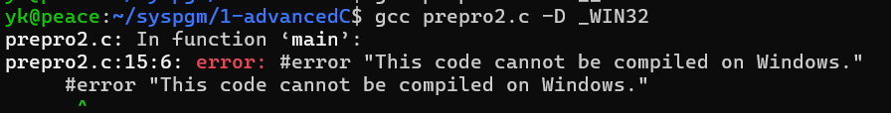
2 Other Compiler Directives
#pragma provides specific instructions to the compiler
#progma instruction
#error generate a compilation error with a custom error message in compile time (not run time message)
#error message
#line changes the current line number
#line line_number [file_name]
int main() {
#ifdef _WIN32
#error "This code cannot be compiled on Windows."
#endif
#line 100 “main.c”
printf("This code is %d in %s\n”, __LINE__, __FILE__);
return 0;
}

Slide 21
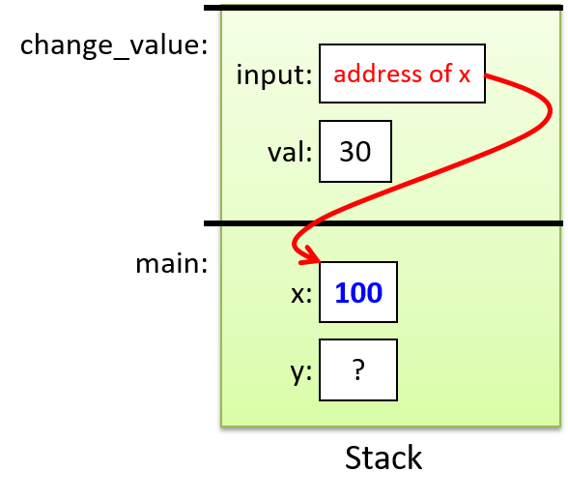
3. Pointers
Pass-by-Pointer (Call by Value of address)
- the value of the address of a storage locationis passed to it by the caller
Example Source Code
#include <stdio.h> int change_value(int *input) { int val = *input; if (val < 100) *input = 100; else *input = val * 2; return val; } int main(void) { int x = 30; int y = change_value(&x); printf("x: %d y: %d\n", x, y); return 0; }
input:
addr of x
val:
?
Execution Result
x: 100 y: 30
x:
30
y:
30
?
Notes:
https://diveintosystems.org/book/C2-C_depth/_images/argv.png

Slide 22
3.1 Pointer to Pointer
Double Pointer
A pointer variable that holds the address of another pointer
Used for multi-dimensional arrays, or functions arguments to modify the pointer itself
ptr_to_ptr.c
int var = 10, *p = &var, **pp = &p; printf("Value of var: %d\n", var); printf("Value using single pointer: %d\n", *p); printf("Value using double pointer: %d\n", **pp); printf("Address of var: %p\n", (void*)&var); printf("Address held by p (Address of var): %p\n", (void*)p); printf("Address of p: %p\n", (void*)&p); printf("Address held by pp (Address of p): %p\n", (void*)pp);
PP:
P:
var:
addr of P
addr of var
10

Slide 23
3.2 Arrays and Pointers
Arrays Name
Array name indicates the address of Beginning of Array (the first array element)
Array name is constant representing address (➔can not be used as lvalue)
Example Source Code
#define N 100 int a[N], *p; p = a; // same as p=&a[0]; a++; // error : a is constant, not variable. p++; // p points to a[1] a = p + 1; // error : a is constant, not variable.

Slide 24
3.2 Arrays and Pointers: Pointer Arithmetics
If a pointer variable points to an array, arithmetic on the pointer to access any of the array’s elements (add constant, subtract constant) is allowed .
A+constant = A + sizeof(element) x constant
Addition with two pointers is not allowed
Multipliaction and Division with pointers is not allow
p
r ≡ q-2
q≡ p+3
ptr_arith.c
#define N 5 int a[N], *p, *q, *r, i; p = a; // Same as p = &a[0]; q = a+3; // Same as q = &a[3]; Adding an integer to a pointer r = q-2; // Same as p = &a[1]; Subtracting an integer from a pointer i = q-p; // Same as i = 3; Subtracting pointers results in the difference in the number of elements between two pointers // Comparison pointer depends on the relative position of two pointers if (p > q) printf(“pointer p has a small index value”); // (p > q) is 0 if (p < q) printf(“pointer p has a large index value”); // (p < q) is 1 if (p == q) printf(“equal index value”); // (p == q) is 0
a:
a[0] | a[1] | a[2] | a[3] | a[4]
address:
a+0 | a+1 | a+2 | a+3 | a+4
physical
address (HEX):
100 | 104 | 108 | 10C | 110
i= p-q ≡ 3
Notes:
포인터 연산은 모든 element가 이어서 memory가 할당되는 한 array에서 수행될 때만 의미가 부여됨
<, >, <=, >=, ==, or != 모두 사용 가능

Slide 25
3.2 Arrays and Pointers
Formula
a[i] ≡ *(a+i)
char *p;
char a[3][2];
a[0] = *a
a[1] = *(a+1)
p = a;
p[0] = *p
p[1] = *(p+1)
char *p;
char a[3];
a[0] = *a
a[1] = *(a+1)
p = a;
p[0] = *p
p[1] = *(p+1)
a[0] a[1] a[2]
p
a:
p[0] p[1] p[2]

Slide 26
3.2 Arrays and Pointers
Using Pointer Arithmetic for Array Processing
ptr + i ➔ ptr + i* sizeof(*ptr)
Example Source Code
#include <stdio.h> int main() { int arr[] = {10, 20, 30, 40, 50}; int *ptr = arr; for (int i = 0; i < 5; i++) printf("arr[%d] = %d\n", i, *(ptr + i)); return 0; }
Execution Result
arr[0] = 10 arr[2] = 20 arr[3] = 30 arr[4] = 40 arr[5] = 50
Watch Out! Even it is convenient to increment a pointer to iterate over an array, it’s easy to make error and more difficult to debug
Formula : A[i] ≡ *(A+i)
Notes:
포인터 연산은 모든 element가 이어서 memory가 할당되는 한 array에서 수행될 때만 의미가 부여됨

Slide 27
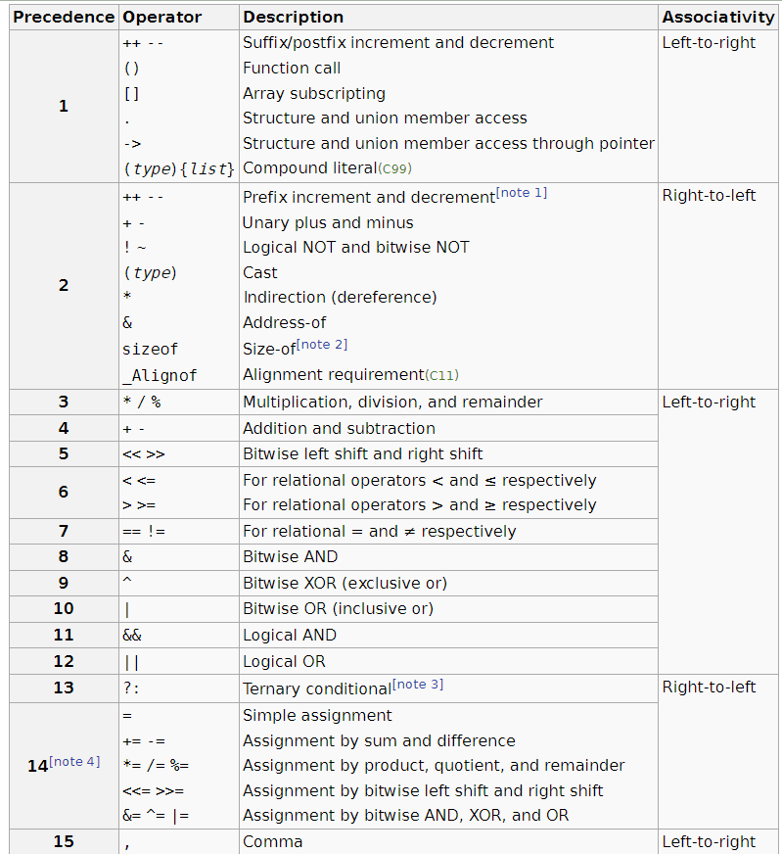
Operator Precedence
highest precedence
left-to-right
associativity
array subscripting([ ]), function call()
subfix/postfix increment/decrement(++,--)
structure member access (. , ->)
indirection(*), address of (&), logical NOT(!), bitwise NOT(~)
prefix increment,decrement(++, --)
Unary plus/minus (+, -)
multiplication, division (*, /, %)
addition, substraction (+,-)
bitwise shift (<<, >>)
Relational operator(<,>,>=,<=)
equivalent (==, !=)
bitwise AND (&)
bitwise XOR(^)
bitwise OR (|)
logical AND (&&)
logical OR (||)
ternary condition ( ?: )
assignment (=, +=, -=, *=, /=, %=, <<=, >>=, &=, |=)
comma (,)
right-to-left
associativity
left-to-right
associativity
right-to-left
associativity
left-to-right
associativity
lowest precedence

Slide 28
3.2 Arrays and Pointers
Pointer with Increment/Decrement Operator
ptr_arith2.c
int arr[3] = {10,20,30}, *ptr, i; ptr = &arr[1]; i = *ptr++; printf(“%d %d”, i, *ptr); // Same as : i = *ptr; ptr++; ptr = &arr[1]; i = *++ptr; printf(“%d %d”, i, *ptr); // Same as : ++ptr; i = *ptr; ptr = &arr[1]; i = ++*ptr; printf(“%d %d”, i, *ptr); // Same as : ++(*ptr); i = *ptr; ptr = &arr[1]; i = (*ptr)++; printf(“%d %d”, i, *ptr); // Same as : i = *ptr; (*ptr)++;
Execution Result
20 30 30 30 21 21 21 22
arr:
10
20
30
precedence: *ptr++ ≡ *(ptr++)
and & has same precedence,
but, right-to-left association
ptr:
++
Notes:
포인터 연산은 모든 element가 이어서 memory가 할당되는 한 array에서 수행될 때만 의미가 부여됨

Slide 29
3.2 Arrays and Pointers
Pointer Arithmetic in Array
Pointer arithmetic works on dynamically allocated arrays, too.
Formula : p[i] ≡ *(p+i)
Example Source Code
#include <stdio.h> #include <stdlib.h> int main() { int num_elements = 5; int *arr; arr = (int *)malloc(num_elements * sizeof(int)); if (arr == NULL) { perror("Failed to allocate memory"); return EXIT_FAILURE; } for (int i = 0; i < num_elements; i++) *(arr + i) = i * 10; for (int i = 0; i < num_elements; i++) printf("arr[%d] = %d %d\n", i, arr[i], *(arr + i)); free(arr); return EXIT_SUCCESS; }
Execution Result
arr[0] = 10 10 arr[2] = 20 20 arr[3] = 30 30 arr[4] = 40 40 arr[5] = 50 50
Tip! void * represents a generic pointer which can point to any or unspecified type
Notes:
https://diveintosystems.org/book/C2-C_depth/_images/argv.png

Slide 30
3.2 Arrays and Pointers
Pointers and Multidimensional Array
Two dimensional array is a array of one-D arrays
Processing the elements of a two-dimensional array
Access elements row by row (row-major order)
Name of the 2-D array can be treated as a pointer-to-pointer which points to the first row (1-D array name)
p ≡ a[0]
row0
row1
row2
Example Source Code
int a[3][5]; int *p = a; // Equivalent to: // p = &a[0][0];
a[0][0] | a[0][1] | … | a[0][4] | a[1][0] | . | a[1][4] | a[2][0] | … | a[2][4]
p+1 ≡ (*a)+1
p+5 ≡ a[1] ≡ *(a+1)
Notes:
https://diveintosystems.org/book/C2-C_depth/_images/argv.png

Slide 31
3.2 Arrays and Pointers
Pointer Arithmetic in Multidimensional Array
Pointer Arithmetic works on Multidimensional arrays too.
ptr_array.c
#include <stdio.h> int main() { int matrix[3][4] = { {1, 2, 3, 4}, {5, 6, 7, 8}, {9, 10, 11, 12} }; int *ptr = &matrix[0][0]; for (int i = 0; i < 3; i++) { for (int j = 0; j < 4; j++) printf("%d ", *(ptr + i*4 + j)); printf(“\n”); } return 0; }
a[0][0] | a[0][1] | … | a[0][4] | a[1][0] | . | a[1][4] | a[2][0] | … | a[2][4]
Execution Result
1 2 3 4 5 6 7 8 9 10 11 12
ptr
ptr+1
ptr+4
ptr+1*4+1
int * ptr ≡ &matrix[0][0]
matrix[i][j] = ptr+i*4 +j
Notes:
https://diveintosystems.org/book/C2-C_depth/_images/argv.png

Slide 32
3.2 Arrays and Pointers : Multidimensional Array
ptr_array2.c
#include <stdio.h> main() { matrix[3][4] = {{1, 2, 3, 4}, {5, 6, 7, 8}, {9, 10, 11, 12}}; for (int i = 0; i < 3; i++) { for (int j = 0; j < 4; j++) { int *q = *(matrix+i)+j; printf("[%d,%d] %p:%d ",i,j, q, *q); } printf("\n"); } int (*p)[4] = matrix; for (int i = 0; i < 3; i++) { for (int j = 0; j < 4; j++) { int *q = p[i]+j; printf("[%d,%d] %p:%d ",i,j, q, *q); } printf("\n"); } }
int A[3][4] ≡ int (*ptr)[4]
/* ptr is a pointer to int [4] */
ptr = a;
Expressions equivalent to a[ i ][ j ] | expressions equivalent to ptr[i][j]
*( a[ i ] + j ) | *(ptr[i]+j)
( *( a + i ) ) [ j ] | (*(ptr+i))[j]
*( *( a + i ) + j ) | *(*(ptr+i)+j)
*( &a[0][0] + 4 * i + j ) | *(&ptr[0][0]+4*i+j)
Column size
Formula for 1-D: A[i] ≡ *(A+i)
for 2-D a[i][j] ≡ *(*(a+i)+j)

Slide 33
3.2. Array of Pointers vs. Pointer to Array
Operator Precedence : index operator([ ] ) > address operator (*)
int (*p)[3] ≡ int ((*p)[3]) ≡ p is a pointer to array of int array of size 3 (int[3])
int * A[3] ≡ int *(A[3]) ≡ A is an array of pointers to int (int *) : A is a constant
address:
*p
*p+1
*p+2
p:
(*p)[0] =p[0][0]
(*p)[1] =p[0][1]
(*p)[2] =p[0][2]
address: A A+1 A+2
A:
address:
*(p+1)
*(p+1)+1
*(p+1)+2
(*(p+1))[0] =p[1][0]
(*(p+1))[1] =p[1][1]
(*(p+1))[2] =p[1][2]
*A[0]
*A[1]
*A[2]
……
address:
*(p+N)
*(p+N)+1
*(p+N)+2
(*(p+N))[0] =p[N][0]
(*(p+N))[1] =p[N][1]
(*(p+N))[2] =p{N][2]
address: A[0] A[1] A[2]

Slide 34
3.2 Arrays and Pointers : Multidimensional Array
Passing Multidimensional Array to Function
For 2-D array, the column size must be specified in parameter
array_to_func_arg.c
void in_d(int *r, int *c, int a[][10]){ int i, j; scanf(“%d%d”, r, c); for(i=0; i< *r; i++) for(j=0 ;j<*c; j++) scanf(“%d”, &a[i][j]); } void oput_d(int r, int c, int (*a)[10]){ int i, j; for(j=0; j<c; j++) printf(“[%d] ”, j); for(i=0; i<r; i++){ printf(“\n[%d] ”, i); for(j=0; j<c; j++) printf(“%3d”, a[i][j]); } }
Execution Result
3 3 1 2 3 4 5 6 7 8 9 [0] [1] [2] [0] 1 2 3 [1] 4 5 6 [2] 7 8 9
a is the pointer-to-array variable that can point to 1st row of table
int main(){ int rows, cols; int table[5][10]; in_d (&rows, &cols, table); oput_d(rows, cols, table); return 0; }
Notes:
2-D array명으로 function호출
Parameter에서 column size반드시 지정 필요
Row size는 생략 가능
why?

Slide 35
3.2. Exercise: Pointer to Array Test Code (Array.c)
#include <stdio.h>
int main() {
int A[10][3];
int (*p)[3];
p = A;
for(int i = 0; i < 10; i++)
{
for(int j = 0; j < 3; j++)
(*p)[j] = i*10+j; /* A[i][j] = i*10+j */
p++;
}
p = A;
for(int i=0; i <10; i++)
{
for(int j=0; j < 3; j++)
printf("%p: p[%1d][%1d]=%3d;",
&p[i][j], i,j, p[i][j]);
printf("\n");
}
for(int i; i <10; i++)
{
printf("A+%1d=%p, *(A+%1d)=%p >> ",i,A+i,i,*(A+i));
for(int j=0; j < 3; j++)
printf("*(A+%1d)+%1d=%p:*(*(A+%1d)+%1d)=%3d;",
i,j, (*(A+i)+j), i,j, *(*(A+i)+j) );
printf("\n");
}
for(int i =0; i < 10; i++)
{
printf("p+%1d=%p, *(p+%1d)=%p >> ",i,p+i,i,*(p+i));
for(int j =0; j< 3; j++)
printf ("*(p+%1d)+%1d=%p:*(*(p+%1d)+%1d))=%3d;",
i,j, (*(p+i)+j), i,j, *(*(p+i)+j));
printf("\n");
}
return 0;
}

Slide 36
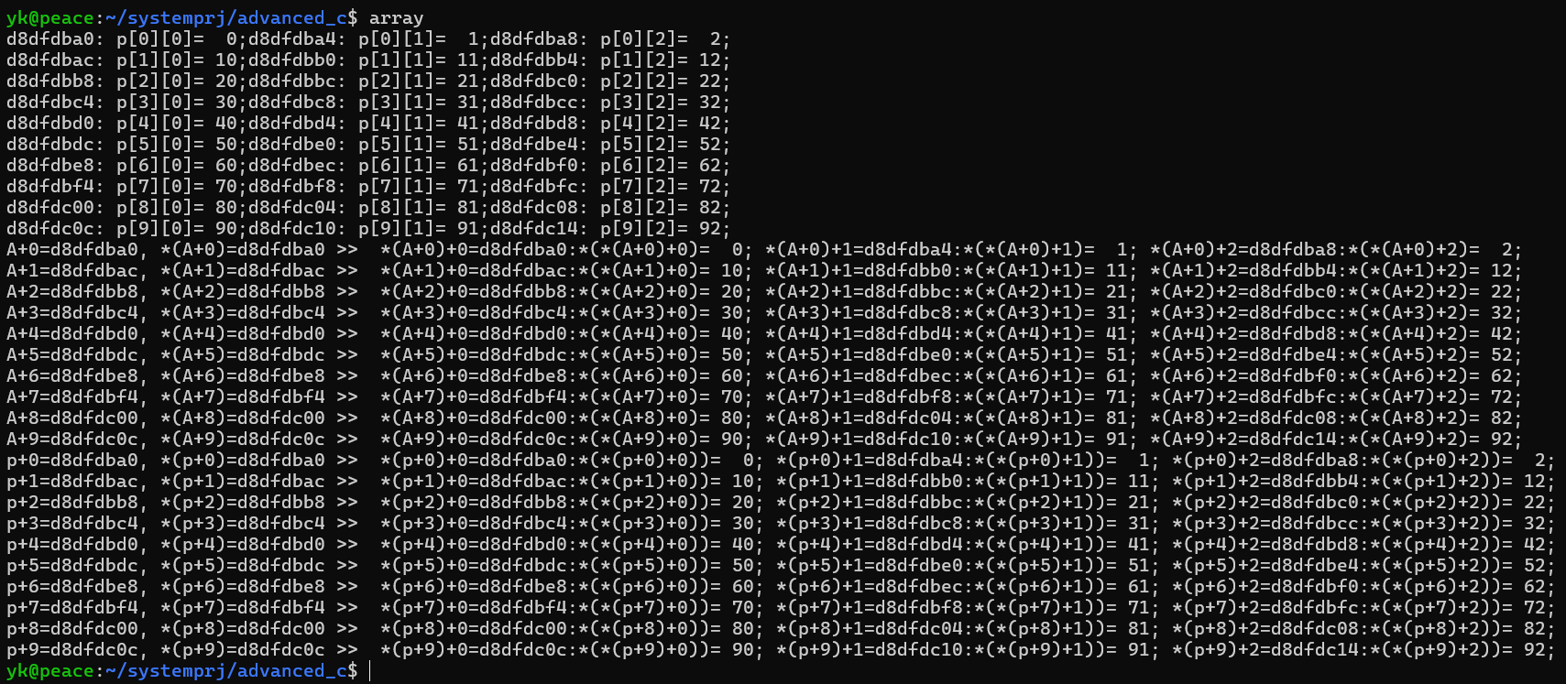
3.2. Exercise: The Execution Results Test Code (Array.c)

Slide 37
3.2 Exercise: Test Result Answer Sheet (Array.c)
*p
*p+2
i | j | p+i points to the entire i-th row of A= A+i; int(*) [3] type (pointer to array[3] of int : entire i-th row) | *(p+i)+j points to the j-the element of the i-th row, or (&A[i][j]). int* type (pointing to a single int) | *(*(p+i)+j) contents of the j-th element of the j-th row (A[i][j]) int type
0 | 0
0 | 1
0 | 2
1 | 0
1 | 1
1 | 2
2 | 0
2 | 1
2 | 2
**p =p[0][0]
0
1
2
p
p+1
10
11
12
p+2
*(p+1)
*(p+1)+1
*(*(p+1)+2)
=p[1][2]
20
21
22
**(p+2)
=p[2][0]
*(p+2)
*(p+2)+1
*(p+2)+2

Slide 38
3.2. Array of Pointers Test(array_pts.c)
for(int i=0; i<10; i++){
printf("%8x: pa[%d]=%8x>> ",
&pa[i], i, pa[i]);
for(int j =0; j <3; j++)
printf(" %8x:pa[%d][%d]=%2d,",
&pa[i][j], i,j,pa[i][j]);
printf("\n");
free(p[i]);
}
return 0;
}
#include <stdio.h>
#include <stdlib.h>
int main()
{
int *pa[10] ;
for(int i=0; i<10; i++){
pa[i] = malloc(sizeof(int)*3);
for(int j =0; j <3; j++)
pa[i][j] = i*10+j;
}
p[0][0]
p[0][1]
p[0][2]
p[0]
p:
array of
10 pointers
to int
p[1]
p[1][0]
p[1][1]
p[1][2]
……
p[9]
p[9][0]
p[9][1]
p[9][2]

Slide 39
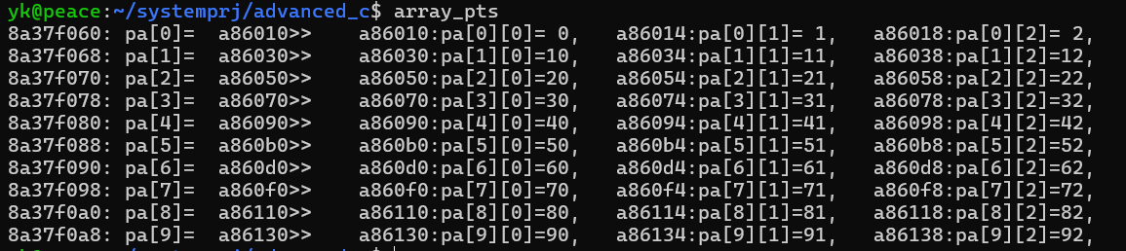
3.2. Array of Pointers Test (array_pts.c)
Fill in the Blanks.
i | j | pa+I = &pa[i] address of i-th pa | &pa[i][j]: address of j-th element of j-th row | pa[i][j]: value of j-th element of i-th row
0 | 0
0 | 1
0 | 2
1 | 0
1 | 1
1 | 2
2 | 0
2 | 1
2 | 2

Slide 40
3.2. Pointer to Pointer Exercise : Pointers to Dynamically Allocated 2-D Arrays (array_dyn.c)
/* array_dyn.c */
#include <stdio.h>
#include <stdlib.h>
int main()
{
int *p[] ;
int *q;
/* alloc array[10] for pointer to int*/
p = malloc(sizeof(int *) * 10);
for(int i =0; i< 10; i++)
{
q = malloc(sizeof(int)*3);
for(int j=0; j <3; j++)
q[j] = i*10+j;
p[i] = q;
}
for(int i = 0; i < 10 ;i++)
{
for(int j = 0; j < 3; j++)
printf("%8x: p[%d][%d]=%2d ",&p[i][j], i,j, p[i][j]);
printf("\n");
}
return 0;
}
array of 3 ints: element is int type
pointer to pointer to int : (int **) type
P
p[0]
p[0][0]
p[0][1]
p[0][2]
p[1]
p[1][0]
p[1][1]
p[1][2]
….
array of 10 pointers to int
: element is (int * ) type
p[9]
p[9][0]
p[9][1]
p[9][2]

Slide 41
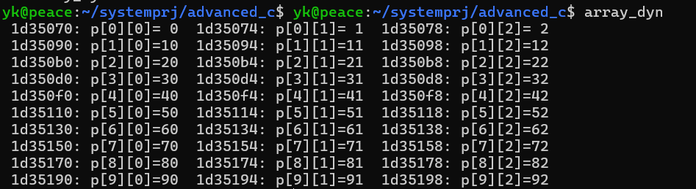
3.2. Pointer to Pointer Exercise: Answer to Test (array_dyn.c)
Fill in the Blanks.
i | j | &p[i][j] = address of each integer elmenet | p[i][j]= contents of each element
0 | 1
0 | 2
0 | 3
1 | 0
1 | 1
1 | 2
2 | 0
2 | 1
2 | 2

Slide 42
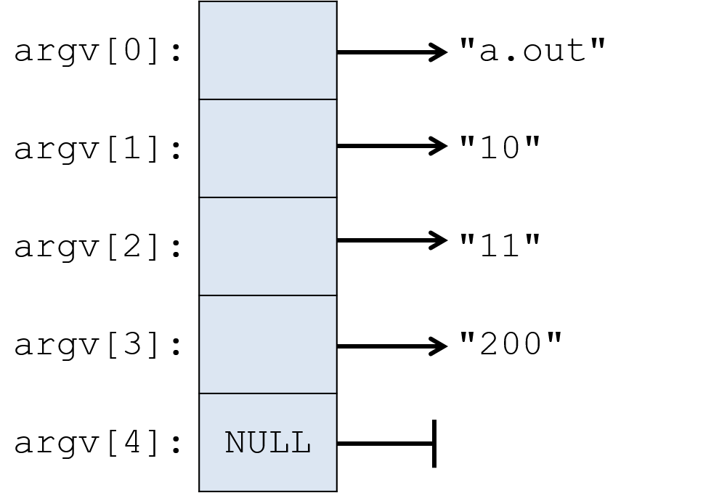
3.3 Command Line Arguments
Command Line Arguments: main(int argc, char *argv[])
int argc stores the number of arguments passed to main()
char * argv[] stores the arguments vector
argc = 4
argv = [“a.out”, “10”, “11”, “200”]
Command Line Example
$ a.out 10 11 200
Tip! All arguments are passed as a string type.
To extract to integer value, use atoi() function
Notes:
https://diveintosystems.org/book/C2-C_depth/_images/argv.png

Slide 43
3.3 Command Line Arguments : (simplecat.c)
/* simplecat.c */
#include <stdop.h>
int main(int argc, char *argv[])
{
FILE *fp;
void filecopy(FILE *, FILE *);
if(argc == 1) /* no args; copy standard input */
filecopy(stdin, stdout);
else
while(--argc >0)
if ((fp= fopen(*++argv, “r”)) == NULL) {
printf(“cat: can’t open %s\n”, *argv);
return 1;
} else {
filecopy(fp, stdout);
fclose(fp);
}
return 0;
}
/* filecopy: copy file ifp to file ofp */
void filecopy(FILE *ifp, FILE *ofp)
{
int c;
while ((c = getc(ifp)) != EOF)
putc(c, ofp);
}
$ cat x.c y.c
→ prints the contents of file x.c and y.c on standard output

Slide 44
3.4 Pointer to Structure
Structures can also be accessed through pointers
typedef struct type_tag { fields } type_name;
type_name *ptr;
ptr_to_struct.c
#include <stdio.h> typedef struct { int x, y; } SAMPLE; int main() { SAMPLE sam1, sam2; SAMPLE *ptr = &sam1; ptr = &sam2; return 0; }
Notes:
https://diveintosystems.org/book/C2-C_depth/_images/argv.png

Slide 45
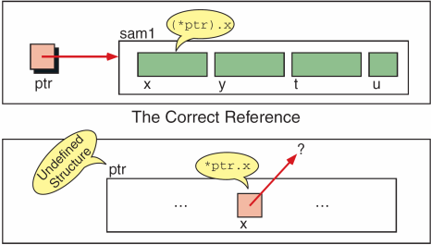
3.4 Pointer to Structure
Two ways to access fields through pointers
ptr_to_struct.c
#include <stdio.h> typedef struct { int x, y; } SAMPLE; int main() { SAMPLE sam1, *ptr; ptr = &sam1; *ptr.x = 100; // incorrect: // member access operator (.) proceeds dereference operator (*) (*ptr).x = 100; // correct (member access operator) ptr->x = 100; // correct (indirect member access operator) sam1.x = 100; return 0; }
Notes:
https://diveintosystems.org/book/C2-C_depth/_images/argv.png

Slide 46
3.4 Pointer to Structure
Function Argument Passing Pointer to Structure
clock.c
typedef struct { int hr, min, sec; } CLOCK; void increment(pClock* pClock) { (pClock->sec)++; if (pClock->sec == 60) { pClock->sec = 0; (pClock->min)++; if (pClock->min == 60) { pClock->min = 0; (pClock->hr)++; if (pClock->hr == 24) pClock->hr = 0; } // if 60 min } // if 60 sec }
void show(pClock *pClock) { printf("%02d:%02d:%02d\n", pClock->hr, pClock->min, pClock->sec); } int main(void) { int i = 0; CLOCK clock = { 14, 38, 56 }; for (i = 0; i < 6; ++i) { increment(&clock); // pass the address show(&clock); // of the structure } return 0; }
Notes:
https://diveintosystems.org/book/C2-C_depth/_images/argv.png

Slide 47
3.5 Pointer to Function
Function Name itself is the address of Code of the Function
Function Pointer Variable:
Stores the address of a function and call the function through the pointer
Syntax:
return_type (*function_pointer)(parameter_types)
ptr_to_func.c
#include <stdio.h> int main() { int (*func)(); func = printf; (*func)(“A function pointer.\n"); return 0; }
Notes:
https://diveintosystems.org/book/C2-C_depth/_images/argv.png

Slide 48
3.5 Pointer to Function
Pointer to Function is useful for implementing callback function or for passing a function as an argument to another function
qsort.c
#include <stdio.h> #include <stdlib.h> int comp(const void *i, const void *j){ return *(int *)i - *(int *)j; } main() { int sort[100], index; for (index = 0; index < 100; index++) sort[index] = rand(); qsort(sort, 100, sizeof(int), comp); for (index = 0; index < 100; index++) printf("%d\n", sort[index]); return 0; }
void qsort(void *base, size_t number, size_t size, int (*comp)(const void *, const void *));
Notes:
https://diveintosystems.org/book/C2-C_depth/_images/argv.png

Slide 49
3.5 Pointer to Function: Array of Pointers to Func
Array of pointers to function is used in implementing function tables to dynamically select and execute functions based on the control variable.
calculator.c
int add(int a, int b) { return a + b; } int sub(int a, int b) { return a - b; } // ... int (*cal[])(int, int) = {add, sub, div, mul}; main() { int res = 0, arg1, arg2, enum Cal cmd; for(;;) { printf(“> “); if((cmd = getcmd()) == -1) break; arg1 = getarg(); arg2 = getarg(); res = (*cal[cmd])(arg1, arg2); } }
// cal is an array of pointer to functions that have (int, int) arguments and return int type.
Execution Result
> add 3 4 7 > sub 9 7 2 > mul 2 2 4
Notes:
https://diveintosystems.org/book/C2-C_depth/_images/argv.png

Slide 50
3.5 Pointer to Function : Example
Complex_ex.c (1)
int compare_int(const void *a, const void *b) { return (*(int *)a - *(int *)b); } int compare_char(const void *a, const void *b) { return (*(char *)a - *(char *)b); } void print_int(const void *elem) { printf("%d ", *(int *)elem); } void print_char(const void *elem) { printf("%c", *(char *)elem); } int main(int argc, char *argv[]) { if (argc < 3) { fprintf(stderr, "Usage: %s <type> <data...>\n", argv[0]); return 1; } char *type = argv[1]; size_t size = argc - 2; void *array; int (*cmp)(const void *, const void *); void (*print_elem)(const void *); size_t elem_size;
Notes:
https://diveintosystems.org/book/C2-C_depth/_images/argv.png

Slide 51
3.5 Pointer to Function
Complex_ex.c (2)
if (strcmp(type, "int") == 0) { elem_size = sizeof(int); int *int_array = malloc(size * elem_size); if (int_array == NULL) { fprintf(stderr, "Memory allocation failed\n"); return 1; } for (size_t i = 0; i < size; i++) { int_array[i] = atoi(argv[i + 2]); } array = int_array; cmp = compare_int; print_elem = print_int; } else if (strcmp(type, "char") == 0) { elem_size = sizeof(char); char *char_array = malloc(size * elem_size); if (char_array == NULL) { fprintf(stderr, "Memory allocation failed\n"); return 1; }
Notes:
https://diveintosystems.org/book/C2-C_depth/_images/argv.png

Slide 52
3.5 Pointer to Function: Example Code
Complex_ex.c (3)
for (size_t i = 0; i < size; i++) { char_array[i] = argv[i + 2][0]; } array = char_array; cmp = compare_char; print_elem = print_char; } else { fprintf(stderr, "Unsupported type: %s. Use 'int' or 'char'.\n", type); return 1; } printf("Before sorting array: "); print_array(array, size, elem_size, print_elem); my_qsort(array, size, elem_size, cmp); printf("After sorting array: "); print_array(array, size, elem_size, print_elem); free(array); return 0; }
Notes:
https://diveintosystems.org/book/C2-C_depth/_images/argv.png

Slide 53
3.5 Pointer to Function: Example Code (4)
Complex_ex.c (4)
#include <stdio.h> #include <stdlib.h> #include <string.h> void swap(void *a, void *b, size_t size) { void *temp = malloc(size); if (temp == NULL) { fprintf(stderr, "Memory allocation failed\n"); exit(1); } memcpy(temp, a, size); memcpy(a, b, size); memcpy(b, temp, size); free(temp); }
Notes:
https://diveintosystems.org/book/C2-C_depth/_images/argv.png

Slide 54
4. typedef
typedef creates aliases for existing types to improve code readability
Syntax:
typedef existing_type new_type_name;
Example Source Code
typedef unsigned int uint; typedef char *char_ptr; struct man { char name[20]; uint age; }; typedef struct man man_t; typedef struct man * man_ptr; char_ptr str; man_t list; man_ptr pointer;

Slide 55
4. typedef
typedef struct {
double r, theta;
} Complex;
/* Complex is a type of struct */
Complex z *zp;
typedef int Length
/* Length is a type of int */
Length len, maxlen
Length *lengths[];
typedef char * String
/* String is a type of char * */
String p, lineptr[NAXLINES]
int strcmp(String, String);
p = (String)malloc(100);
typedef int (*PFI) (char *, char *)
/* PFI is a type of pointer to function (of two char * arguments) returning int */
PFI strcmp, numcmp;

Slide 56
4. typedef
typedef for struct creates an alias for struct type
Example Source Code
typedef unsigned int uint; struct man { char name[20]; uint age; }; typedef struct man man_t; typedef struct man * man_ptr; struct man list1; man_t list2; // Just use man_t instead of struct ... man_ptr ptr_list;
Notes:
typdefef for struct
typedef for function
typedef for array
typedef for complex data structure

Slide 57
4. typedef
typedef_func.c
// define function pointer type typedef int (*OperationFunc)(int, int); int add(int a, int b) { return a + b; } int multiply(int a, int b) { return a * b; } int main() { OperationFunc func_ptr; /* int(*OperationFunc)(int,int)*/ func_ptr = add; printf("Result of add operation: %d\n", func_ptr(3,4)); func_ptr = multiply; printf("Result of multiply” “operation: %d\n", func_ptr(3,4)); return 0; }
typedef for function is useful to simplify function pointer declarations, making them easier to read and use
Notes:
typdefef for struct
typedef for function
typedef for array
typedef for complex data structure

Slide 58
4. typedef
typedef for array creates a new type name, simplifying declarations
typedef_array.c
// Define a typedef for an array of 5 integers typedef int IntArray[5]; int main() { IntArray numbers = {1, 2, 3, 4, 5}; printf("Array elements: "); for (int i = 0; i < 5; ++i) { printf("%d ", numbers[i]); } printf("\n"); return 0; }
Notes:
typdefef for struct
typedef for function
typedef for array
typedef for complex data structure

Slide 59
4. typedef
void inOrderTraversal(NodeP root) { if (root == NULL) return; inOrderTraversal(root->left); printf("%d ", root->data); inOrderTraversal(root->right); } int main() { Node* root = createNode(1); root->left = createNode(2); root->right = createNode(3); root->left->left = createNode(4); root->left->right = createNode(5); printf("In-order traversal: "); inOrderTraversal(root); printf("\n"); // ... (omitted) return 0; }
typedef for complex data structure
tree.c
typedef struct TreeNode { int data; struct TreeNode* left; struct TreeNode* right; } Node; typedef struct TreeNode* NodeP; struct TreeNode* createNode(int data) { Node* newNode = (Node*)malloc(sizeof(Node)); newNode->data = data; newNode->left = NULL; newNode->right = NULL; return newNode; }
Notes:
typdefef for struct
typedef for function
typedef for array
typedef for complex data structure

Slide 60
4. typedef
typedef vs. Macro with #define
Type definitions are more powerful than macro definitions
Name of typedef are subject to the same scope rules as variables
Example Source Code
#define PTR_TO_INT int * PTR_TO_INT p, q, r; // will become: int * p, q, r; typedef int * PTR_TO_INT; PTR_TO_INT p, q, r; // will become: int * p, * q, * r;
Notes:
첫째, type definition이 macro보다 강력하다. 실제로, array와 pointer 타입은 macro로 정의하는 것을 권장하지 않는다.
예)
#define PTR_TO_INT int *
PTR_TO_INT p, q, r; => int * p, q, r;
typedef는 위의 문제가 발생하지 않는다.
둘째, typedef는 variable과 동일한 scope를 가진다. 함수 내에서 선언하면 함수 내에서만 유용하다. macro는 파일 끝/undef 되기 전까지 wherever 대체된다.
Note! typedef는 컴파일러에 의해, #define은 전처리기에 의해 처리된다.

Slide 61
4. Type Summary
int x : int
int *x : pointer to int
int *x[3] : array of 3 pointers to int
int (*x)[3] : pointer to array of 3 int
int *f() : function returning pointer to int
int (*f) () : pointer to function returning int
int * (*f)() : pointer to function returning pointer to int
int (*f[3])(void) : array of 3 pointers to functions with no args returning int

Slide 62
5. Enumerated Type
enum represents a limited set of integer values, each with a name
Syntax:
enum type_tag {enumeration_values};
enum.c
#define MAX_SIZE 10 enum Status { SUCCESS, FAILURE }; enum Status checkSize(int size) { return (size <= MAX_SIZE) ? SUCCESS : FAILURE; } int main() { int size = 8; if (checkSize(size) == SUCCESS) printf("Size is within limits.\n"); else printf("Size exceeds limits.\n"); return 0; }

Slide 63
5. Enumerated Type
Initializing Enumerated Constants
Enumerated constants are assigned with integer values starting from 0 as default
If Explicit constant are assigned to enumerated, the following contents continue from that value
enum.c
enum Color { RED, // 0 by default GREEN, // 1 BLUE // 2 }; enum ResponseCode { OK = 200, // Explicitly set to 200 CREATED = 201, // 201 ACCEPTED = 202, // 202 NO_CONTENT = 204, // 204 BAD_REQUEST = 400,// Explicitly set to 400 UNAUTHORIZED, // 401 (incrementing by 1 from previous value) FORBIDDEN // 402 };

Slide 64
5. Enumerated Type
Using enum in practice
enum type_tag specifies a user-defined data type in function parameter or variable declaration
If an enumeration is declared inside a function, its constants won’t be visible outside the function
enum.c
enum Color { // definition of Color type RED, // 0 by default GREEN, // 1 BLUE // 2 }; int func(enum Color curColor) { enum Color backgroundColor, foregroundColor; // variable declarations backgroundColor = BLUE; // enum type assignment …… // omitted return selectedColor; }

Slide 65
5. Enumerated Type
Enumeration and #define
Although enumerations are similar to constants created with #define directive, enumeration constants are subject to C’s scope rule
Unnamed enum defines constants with restricted values but without creating a reusable type
enum.c
// Using macros to define a color “type” and names for the various color #define Color int #define RED 0 #define GREED 1 #define BLUE 2 Color c1, c2; c1 = BLUE; c2 = RED | // To indicate the “type” of the value macros represent enum Color { RED, GREEN, BLUE }; enum Color c1, c2; c1 = BLUE; c2 = RED; // Unnamed enum is useful for local or one-time use cases enum { RED, GREEN, BLUE } c1, c2; c1 = BLUE; c2 = RED;
Note! It is convention to use capital letters for enumerated names and defined constants

Slide 66
5. Enumerate vs. typedef
Enumeration vs. typedef
As an alternative of enum variable declaration syntax (enum type_tag), use typedef to make type name
typedef enum {RED, GREEN, BLUE} Color;
Color c1, c2;
Using typedef is an excellent way to create a Boolean type:
typedef enum {FALSE, TRUE} Bool;
Notes:
첫째, type definition이 macro보다 강력하다. 실제로, array와 pointer 타입은 macro로 정의하는 것을 권장하지 않는다.
예)
#define PTR_TO_INT int *
PTR_TO_INT p, q, r; => int * p, q, r;
typedef는 위의 문제가 발생하지 않는다.
둘째, typedef는 variable과 동일한 scope를 가진다. 함수 내에서 선언하면 함수 내에서만 유용하다. macro는 파일 끝/undef 되기 전까지 wherever 대체된다.
Note! typedef는 컴파일러에 의해, #define은 전처리기에 의해 처리된다.

Slide 67
6. Bitwise Operators
1) Bitwise AND &
c = a & b
2) Bitwise Exclusive OR ^
c = a ^ b
3) Bitwise Inclusive OR |
c = a | b
& | 0 | 1
0 | 0 | 0
1 | 0 | 1
0 0 0 0 0 0 0 0 0 1 1 0 0 0 0 1 | 97
0 0 0 0 0 0 0 0 0 1 0 1 1 1 1 1 | 95
0 0 0 0 0 0 0 0 0 1 0 0 0 0 0 1 | 65
&
^ | 0 | 1
0 | 0 | 1
1 | 1 | 0
0 0 0 0 0 0 0 0 0 1 1 0 0 0 0 1 | 97
0 0 0 0 0 0 0 0 0 1 0 1 1 1 1 1 | 95
0 0 0 0 0 0 0 0 0 0 1 1 1 1 1 0 | 62
^
| | 0 | 1
0 | 0 | 1
1 | 1 | 1
0 0 0 0 0 0 0 0 0 1 1 0 0 0 0 1 | 97
0 0 0 0 0 0 0 0 0 1 0 1 1 1 1 1 | 95
0 0 0 0 0 0 0 0 0 1 1 1 1 1 1 1 | 127
|
Notes:
https://diveintosystems.org/book/C2-C_depth/_images/argv.png

Slide 68
6. Bitwise Operators
4) Bitwise Complement ~
a = ~b
5) Shift Left <<
c = a << b
c = a >> b
6) Shift Right >>
Arithmetic Shift : Fill the left empty space with the most left bit (signed bit)
Logical Shift : Fill the left empty space only with 0
 | ~
0 | 1
1 | 0
0 0 0 0 0 0 0 0 0 1 1 0 0 0 0 1 | 97
0 0 0 0 0 0 0 0 0 1 0 0 0 0 0 1 | 65
~
Tip! After shift left, right empty space is always filled with 0
a<<3
0 0 0 0 0 0 0 0 0 0 0 1 0 1 1 1 0 0 0 | 184
0 0 0 0 0 0 0 0 0 0 0 1 0 1 1 1 | 23
0 0 0 0 0 0 0 0 0 0 0 0 0 0 1 0 1 1 1 | 2
a>>3
a<<3
1 1 1 1 1 1 1 1 1 1 1 0 1 0 0 1 0 0 0 | -184
1 1 1 1 1 1 1 1 1 1 1 0 1 0 0 1 | -23
1 1 1 1 1 1 1 1 1 1 1 1 1 1 0 1 0 0 1 | -3
a>>3
Notes:
https://diveintosystems.org/book/C2-C_depth/_images/argv.png

Slide 69
6. Bitwise Operators
Example Source Code (bitwise.c)
#include <stdio.h> void bdisp(unsigned int c){ int i, wc; for (i=sizeof(unsigned int)*8-1; i>=0; i--) { wc = (c >> i) & 0x00000001; printf("%1d", wc); if(i%8==0 && i != 0) printf("_"); } printf("\n"); } int main() { int x = 123, y; printf("%8s%9s%15s\t%s\n", "expr", "decimal", "hexadecimal", "bit pattern"); y = x; printf("%8s%9d%15x\t","x", y, y); bdisp(y); y = ~x; printf("%8s%9d%15x\t","~x", y, y); bdisp(y); y = x | 128; printf("%8s%9d%15x\t","x| 128", y, y); bdisp(y); y = ~x >> 2; printf("%8s%9d%15x\t","~x >>2", y, y); bdisp(y); y = x << 8; printf("%8s%9d%15x\t","x << 8", y, y); bdisp(y); return 0; }
Execution Result
expr decimal hexa bit pattern x 123 7b 00000000_00000000_00000000_01111011 ~x -124 ffffff84 11111111_11111111_11111111_10000100 x|128 251 fb 00000000_00000000_00000000_11111011 ~x>>2 -31 ffffffe1 11111111_11111111_11111111_11100001 x<< 8 31488 7b00 00000000_00000000_01111011_00000000
Notes:
https://diveintosystems.org/book/C2-C_depth/_images/argv.png

Slide 70
Quiz: Write Functions getbits, bitcount, and rightrot
Q1. unsigned getbits(int x,int p,int n): a function that returns right-adjusted n-bit filed of x that begins at a position p
/* Ans */ unsigned getbits (int x, int p, int n) {
return (( x >> p – n + 1) & ~(~0 << n));
}
Q2. int bitcount(int x): a function that returns the number of ‘1’ in a binary value of x
Q3.unsigned rightrot(int x, int n): a function returns the value of x rotated to the right by n bit position
0000 ……………. 00000
11...11
p
n
n
&
x:
31 0
n
n
x:

Slide 71
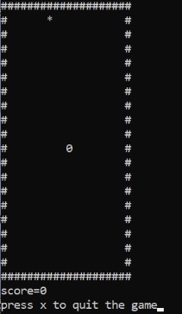
Problem: Snake Game in C
Below given some functionalities of this game:
The snake is represented with a 0(zero) symbol.
The fruit is represented with an *(asterisk) symbol.
The snake can move in any direction according to the user with the help of the keyboard (W, A, S, D keys).
When the snake eats a fruit the score will increase by 10 points.
The fruit will generate automatically randomly within the boundaries.
Whenever the snake will touch the boundary the game is over.
Use multiple C source files (main.c, setup.c, logic.c, draw.c, input.c) and a common header file (game.h)

Slide 72
Ans(1). to Problem
// File draw.c
// Function to draw the boundaries
#include “game.h”
void draw() {
system("cls");
for (i = 0; i < height; i++) {
for (j = 0; j < width; j++) {
if (i == 0 || i == width - 1 || j == 0
|| j == height - 1) {
printf("#");
} else {
if (i == x && j == y)
printf("0");
else if (i == fruitx && j == fruity)
printf("*");
else
printf(" ");
}
}
printf("\n");
}
// Print the score after the game ends
printf("score = %d", score);
printf("\n");
printf("press X to quit the game");
}
// File : main.c
// C program to build the
// complete snake game
#include <conio.h>
#include <stdio.h>
#include <stdlib.h>
#include <unistd.h>
int i, j, height = 20, width = 20;
int gameover, score;
int x, y, fruitx, fruity, flag;
void main()
{
int m, n;
setup();
while (!gameover) {
// Function Call
draw();
input();
logic();
}
}
// File: setup.c
// Function to generate the fruit
// within boundary
#include “game.h”
void setup()
{
gameover = 0;
// Stores height and width
x = height / 2;
y = width / 2;
label1:
fruitx = rand() % 20;
if (fruitx == 0)
goto label1;
label2:
fruity = rand() % 20;
if (fruity == 0)
goto label2;
score = 0;
}

Slide 73
Ans(2) to Problem
// File: input.c
#include “game.h”
void input() {
if (kbhit()) {
switch (getch()) {
case 'a':
flag = 1;
break;
case 's':
flag = 2;
break;
case 'd':
flag = 3;
break;
case 'w':
flag = 4;
break;
case 'x':
gameover = 1;
break;
}
}
} // end of input function
// File: logic.c
// Function for the logic
// behind each movement
#include “game.h”
void logic()
{
sleep(0.01);
switch (flag) {
case 1:
y--;
break;
case 2:
x++;
break;
case 3:
y++;
break;
case 4:
x--;
break;
default:
break;
}
// File : logic.c
// If the game is over
if (x < 0 || x > height
|| y < 0 || y > width)
gameover = 1;
// If snake reaches the fruit
// then update the score
if (x == fruitx && y == fruity) {
label3:
fruitx = rand() % 20;
if (fruitx == 0)
goto label3;
// After eating the above fruit
// generate new fruit
label4:
fruity = rand() % 20;
if (fruity == 0)
goto label4;
score += 10;
}
} // end of logic function

Slide 74
References
https://gcc.gnu.org/onlinedocs/gcc-3.3.6/cpp/Macros.html#Macros
https://www.geeksforgeeks.org/c-pointers/

